Slide 1
CoursERA Applied data science capstone
By: Jonathan klausner

Slide 2
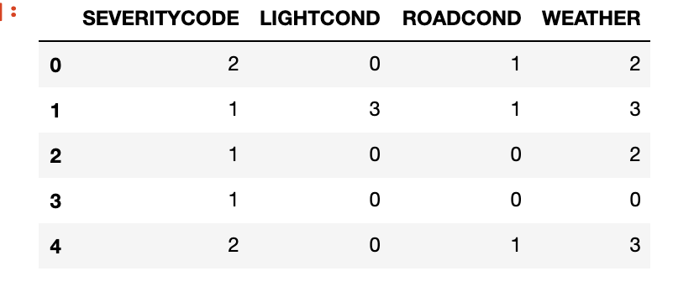
Accident Severity Predicted by Road and Light Conditions and Weather
Road and Light conditions are very important to the driver
One thing to keep in mind is that weather is a feature that could have a large impact on the other features
These were selected because they were all environmental aspects of car accidents that are not impacted by the drivers involved in the accident themsekves

Slide 3
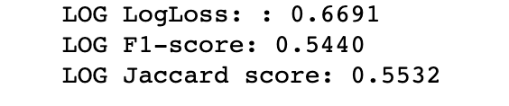
Results
From executing a logistic regression model the results below show that there is more information needed to predict accident severity but that things such as weather do play a large roll in the outcomes

Slide 4
Conclusion
This project attempted to create a model that could predict the severity of car accidents based on outside forces out of control of the driver.
Accuracy of the model has much to be desired by including other features
Need to add fatalities and injury type
Get hospital data for those that were checked in due to car accident suffered injuries

